Slide 1
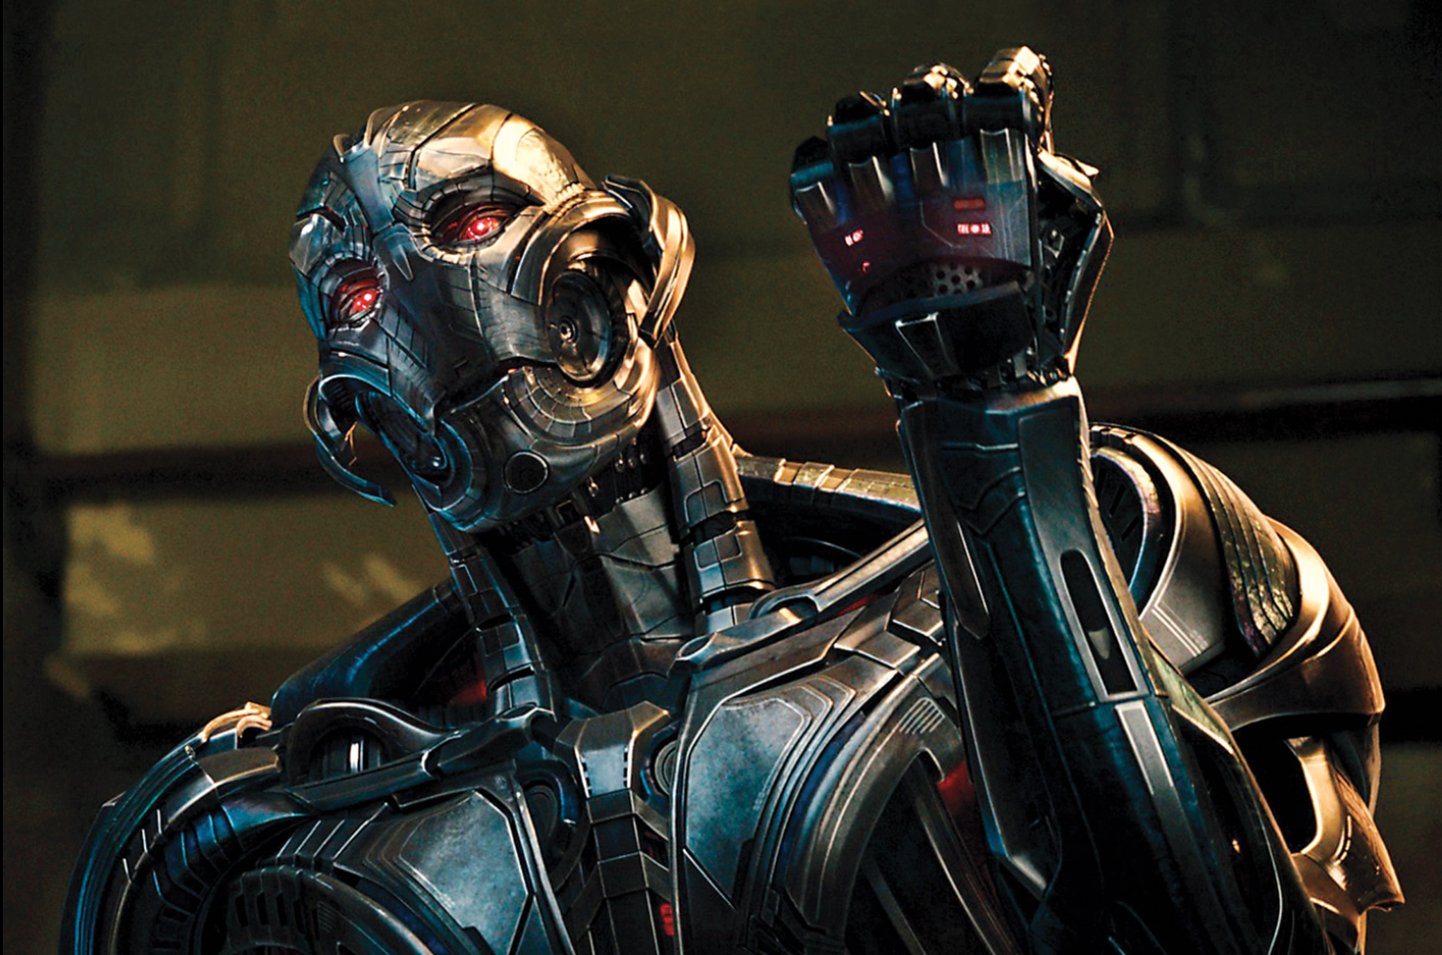
Beware of roBots

Slide 2
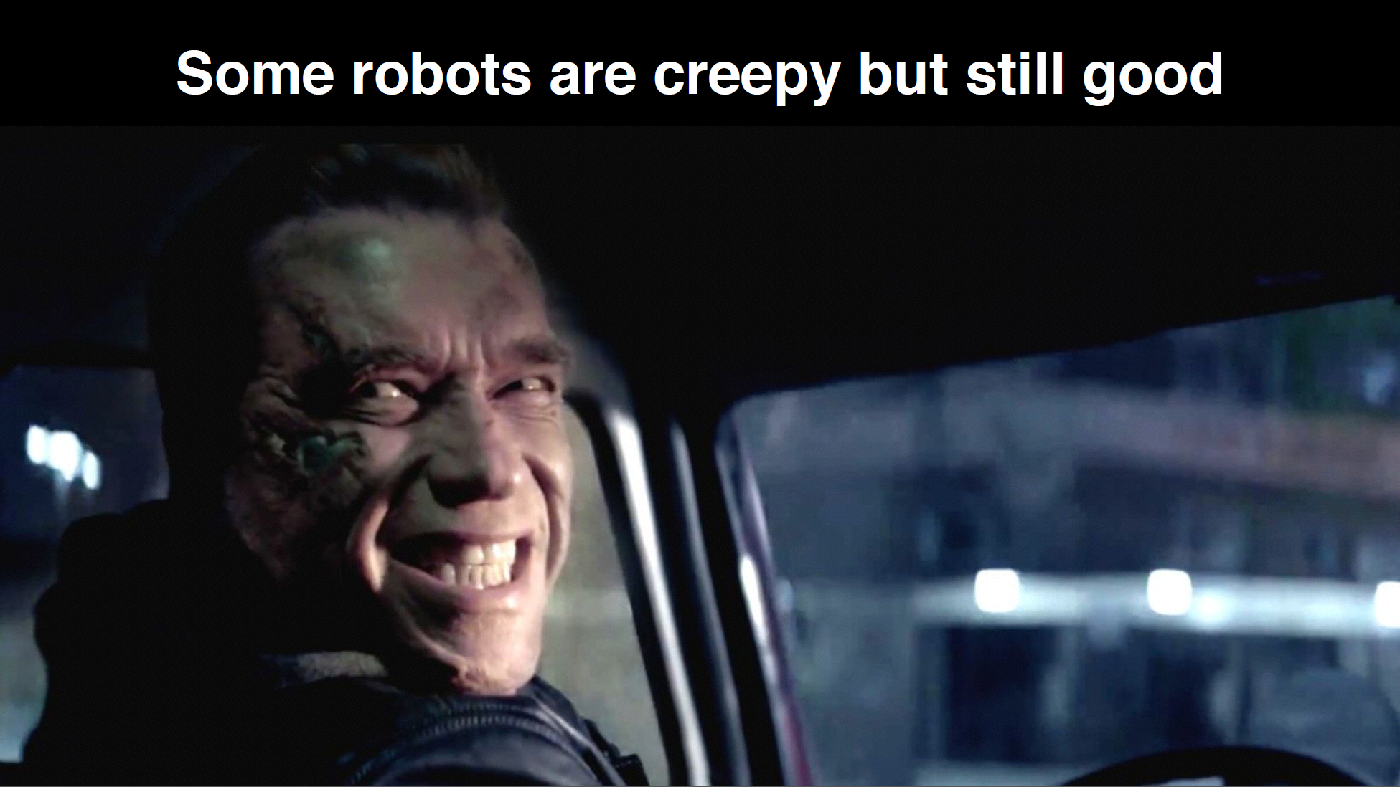

Slide 3
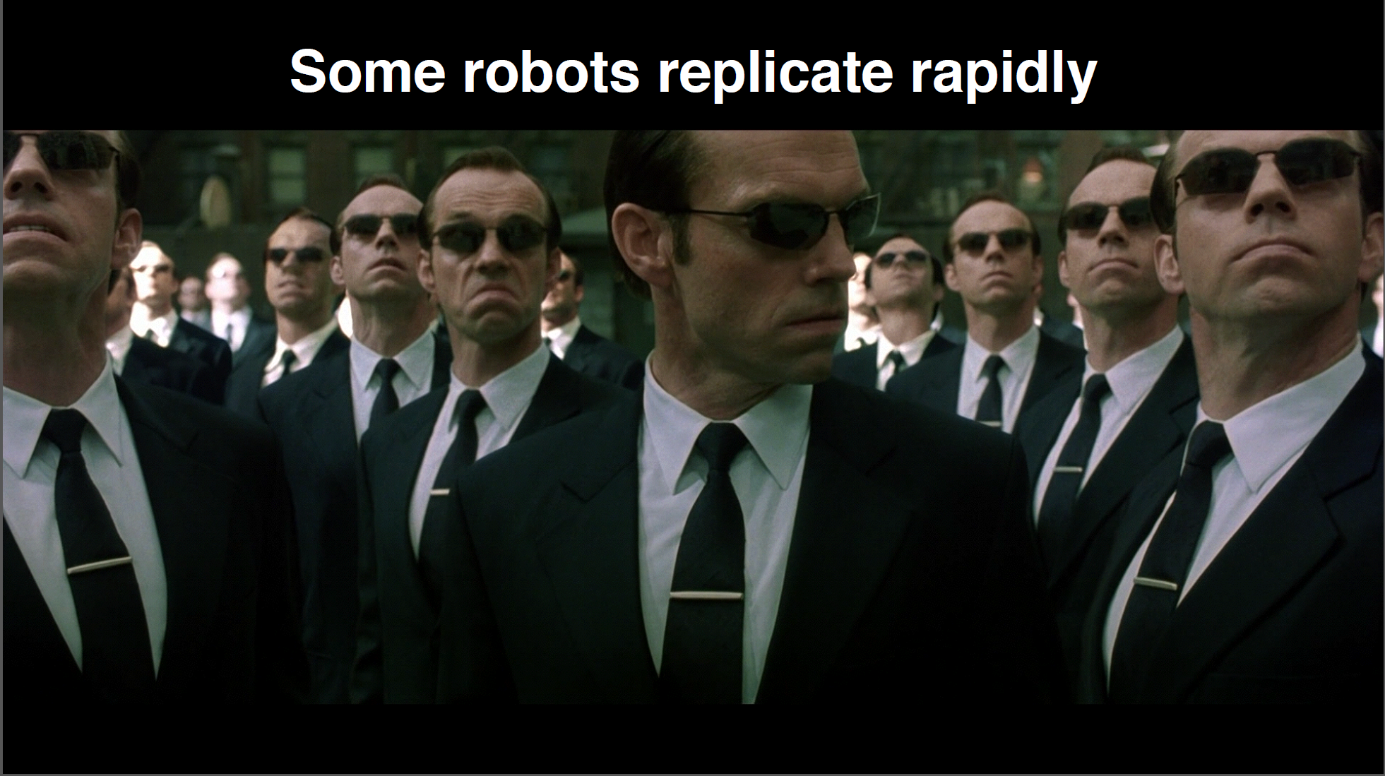

Slide 4
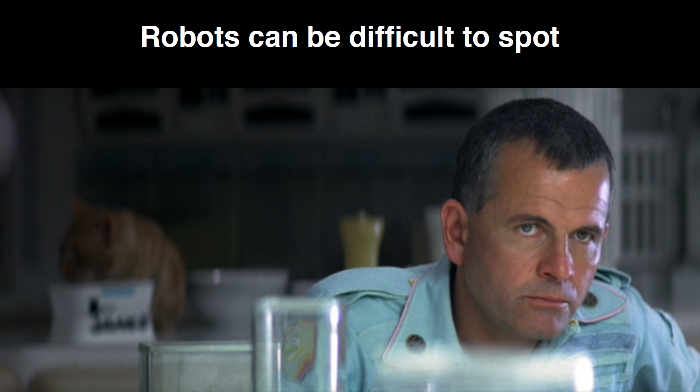

Slide 5
How do you identify a robot?

Slide 6
Bots and security

Slide 8
What are bad guys doing with botnets?

Slide 10
Click fraud
Pay-per-click model
$23B in annual revenue
>$100K per minute
One main incentive
Many methods

Slide 11
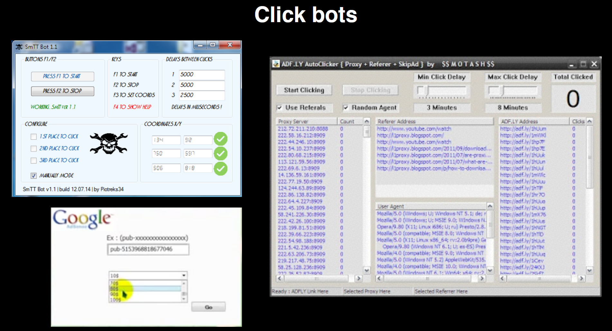

Slide 12
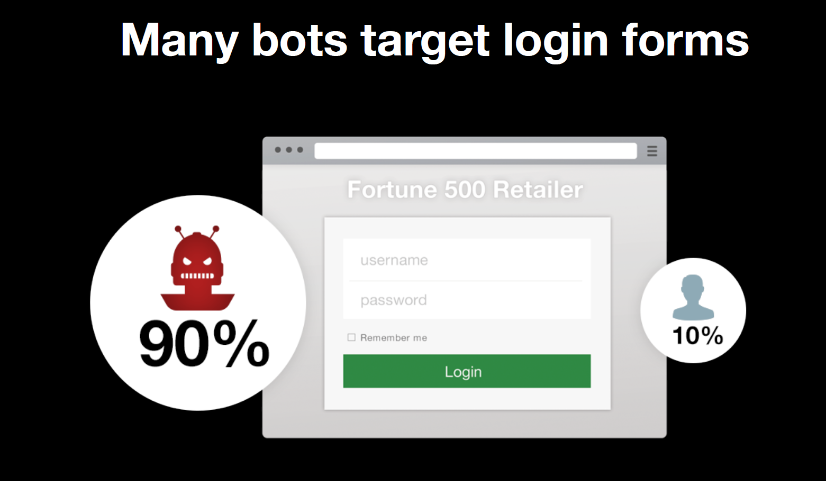

Slide 13
A real example

Slide 16
Creating a successful bot
To successfully imitate a crowd attackers need to vary
Screen resolution
Timezone
Browser version
Language
Fonts
Browser Plugins
Type of Pointing Device
Many other browser features
Source: http://www.infoq.com/

Slide 17
Generalized attack mitigation
Prevention
Removing Attack incentives
Reducing Attack
Surface
Real-Timed
Detection
Real-Time Detection
Near Real-Time
Detection
Batch Detection & Invistigation
Batch
Detection Rules
Data Feeds
Reactive Investigation
ProactiveManual
Investigation
Reactive Manual
Investigation
Disrupting & Deflecting Attacks

Slide 18
Thanks to
Infoq.com
Shuman Ghosemajumder
sg@shapesecurity.com

