Slide 1
Blockchain – the basics
Michael Claudius, Associate Professor, Roskilde

Slide 2
What is blockchain?
A distributed ledger. Keeps tracks of all transactions from start up till now.
P2P network with nodes/peers (members). We are all equal!
100% Decentralized.
100% redundant information. We all have the same bitcoin block!
A chain of blocks
Each block has a reference to the previous block

Slide 3
History the start 1991
Stuart Haber & W. Scott Stornetta 1991, one block one document
Bayer, Haber and Stornetta 1992: Merkle trees: one block several documents (transactions)
Satoshi Nakamoto 2008,
Bitcoin article: https://bitcoin.org/bitcoin.pdf

Slide 4
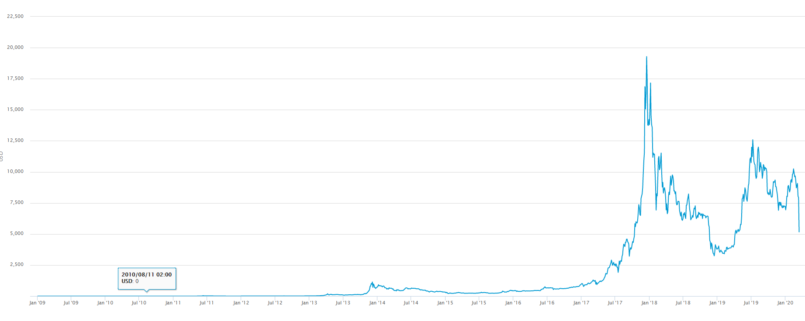
Bitcoin, Exchange rate

Slide 5
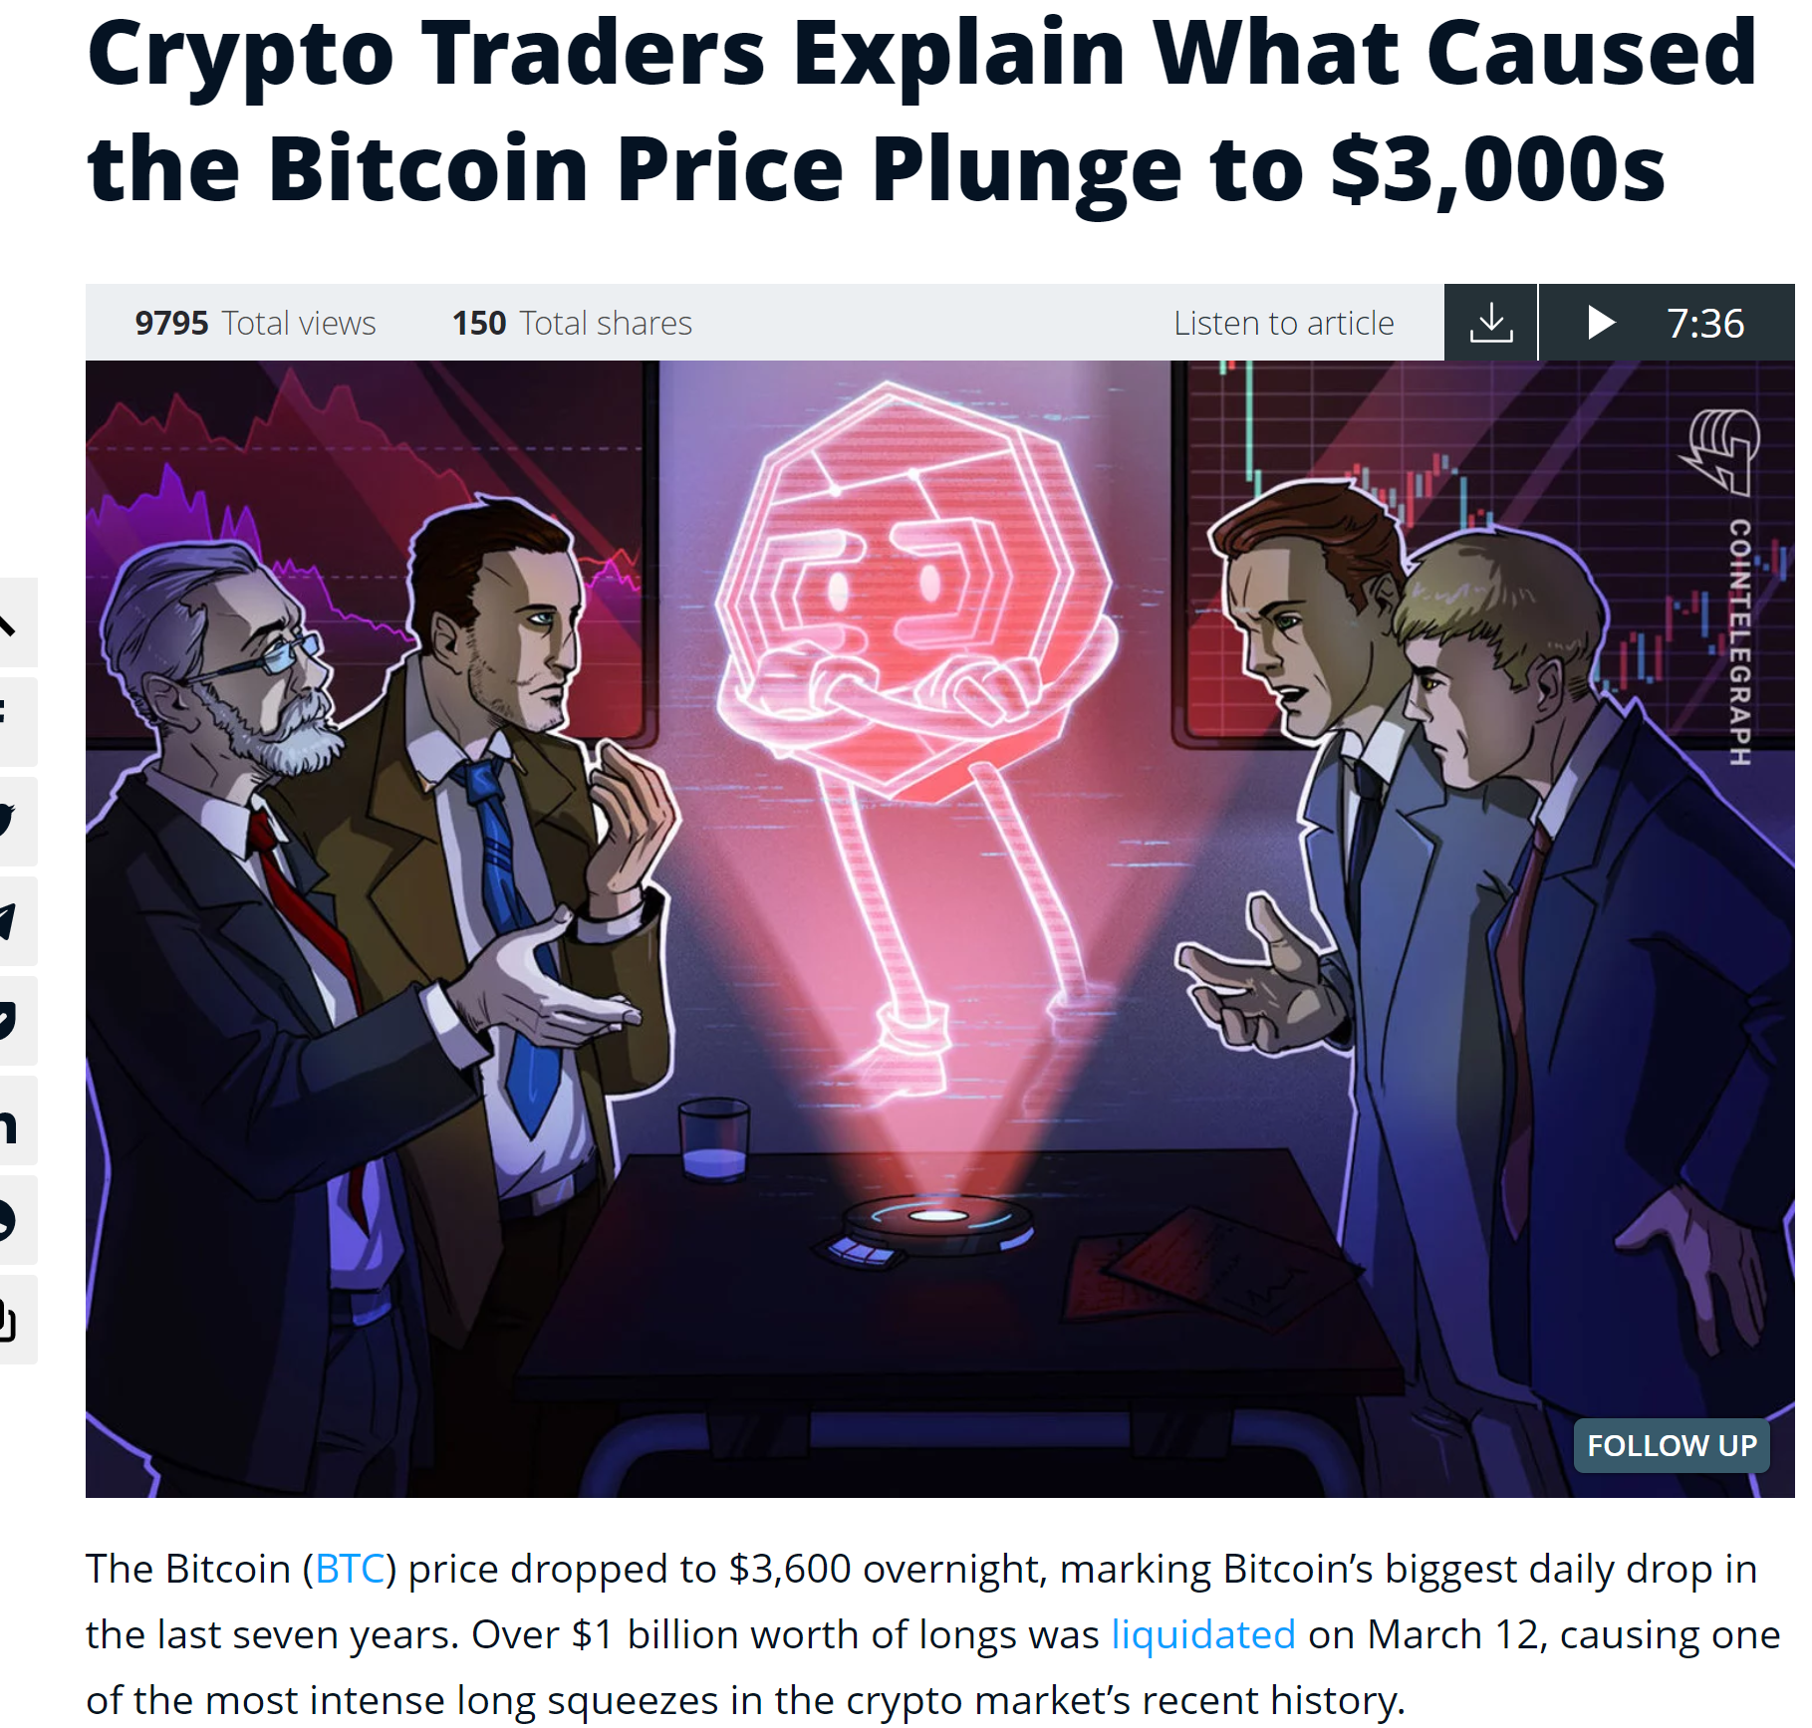
Bitcoin
Bitcoin, https://www.bitcoin.com/

Slide 6
Well known examples
Bitcoin, https://www.bitcoin.com/
Ethereum
Shipping applied
More examples, you will find them later !
Lets see blockchain in action: BlockChain Introduction (6 minutes)

Slide 7
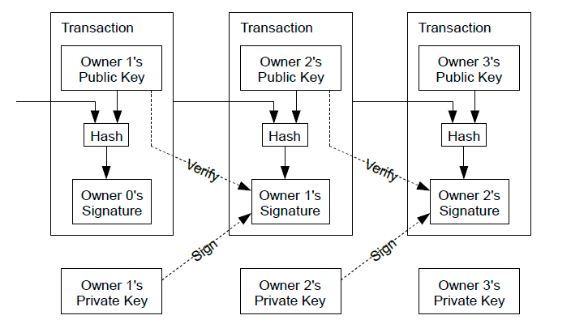
Transactions (T)
Problem: How to transfer an electronic coin from Owner no. 1 to Owner no. 2: O1 ->-----T₁----> O2
Solutions: Each owner signs a hash of previous transaction. K₁⁻(H(T₁,K₂⁺))

Slide 8
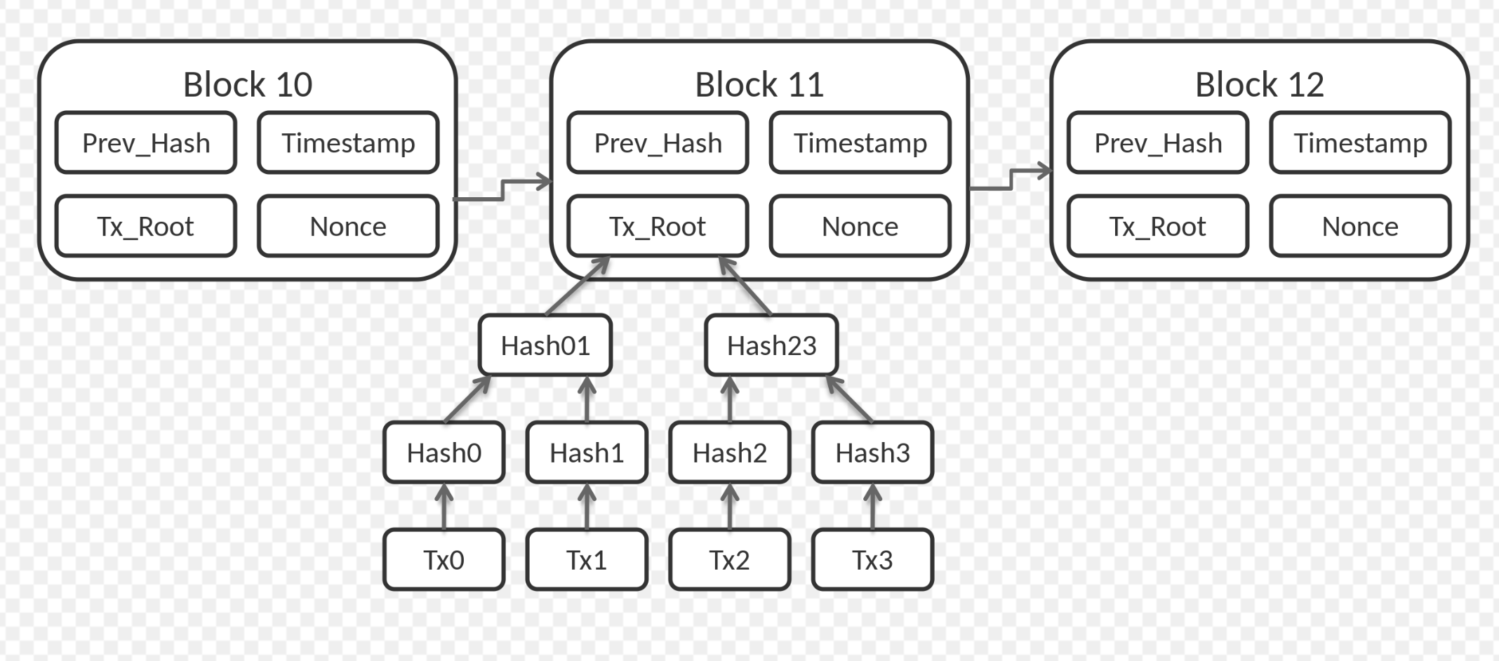
Security
Problem: How to avoid one sneaky node to spend the same the e-coin two times (double spending problem?
Solution: All nodes know all transactions and must agree on this
Ensure the order by a timestamp. Hash[Hash(previous block), timestamp, transaction data]

Slide 9
Security
Problem: How to ensure nobody can tamper a hash value in block ?
Solution: Proof of work, add a nonce to the block.
The nonce is found by incrementing the value untill the block’s hash begins with required number of zeros
The more zeroes, the more difficult, the longer time it will take to generate a block
Since the hash changed all later blocks declare the block for invalid

Slide 10
The network procedure
1) New transactions are broadcast to all nodes.
2) Each node collects new transactions into a block.
3) Each node works on finding a difficult proof-of-work for its block.
4) When a node finds a proof-of-work, it broadcasts the block to all nodes.
5) Nodes accept the block only if all transactions in it are valid and not already spent.
6) Nodes express their acceptance of the block by working on creating the next block in the
chain, using the hash of the accepted block as the previous hash.
Lets see it in action: Secret Chinese Bitcoin Mine

Slide 11
Security
Problem: How to avoid one miner getting the 51% power in bitcoin
Solution: Control the difficulty of “Proof of work”. Too fast increase difficulty, too slow decrease difficulty

Slide 12
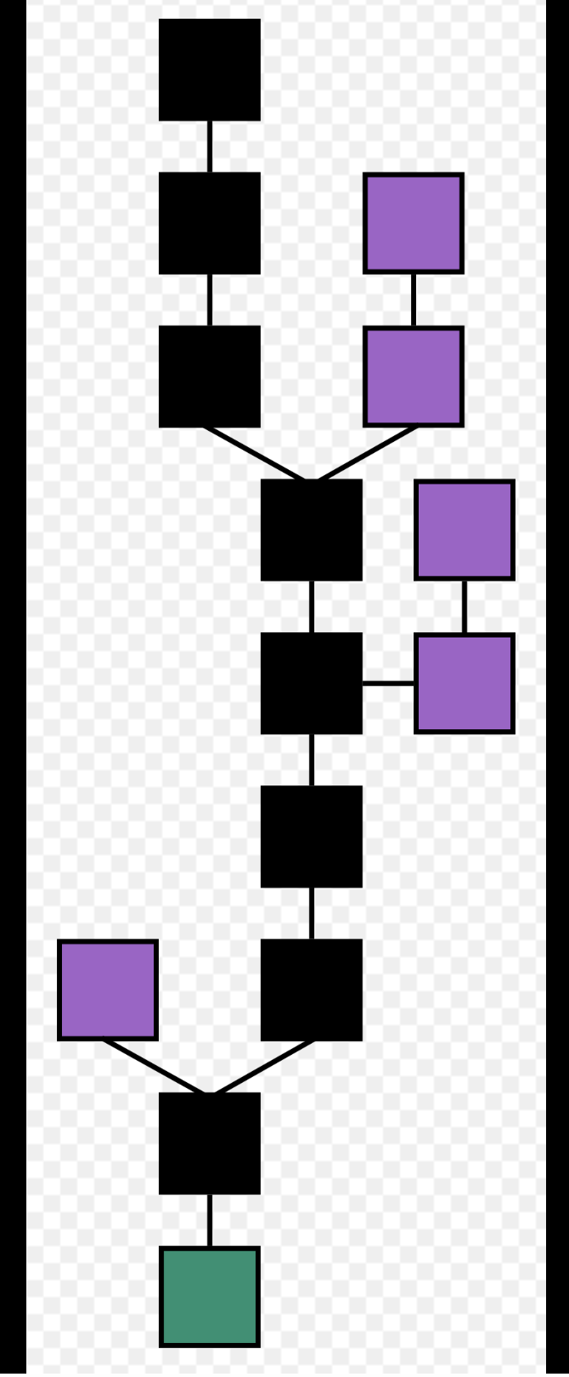
Temporary fork
Problem: What if two miners at the same time solves the block and a node receives two blocks at the nearly same time?
Solution: Choose later the longest chain when transactions covered by many others, I.e. wait 6 blocks..

Slide 13
Hard fork
Problem: Attacked by hacker due to SW error.
Solution: Hard fork 51% agreement needed.
Success: All nodes change old SW to new SW. Succes for Ethereum split into new and clssiv
Failure: All nodes deny and old SW is not replaced new SW. Failure then what ? Worst case: Pay ransom Nxt 50 million ?!
Can you Google other attacks ?

Slide 14
Assignments
Time for a little discussion and some work.
Blockchain questions
Mandatory Blockchain project

